Slide 1
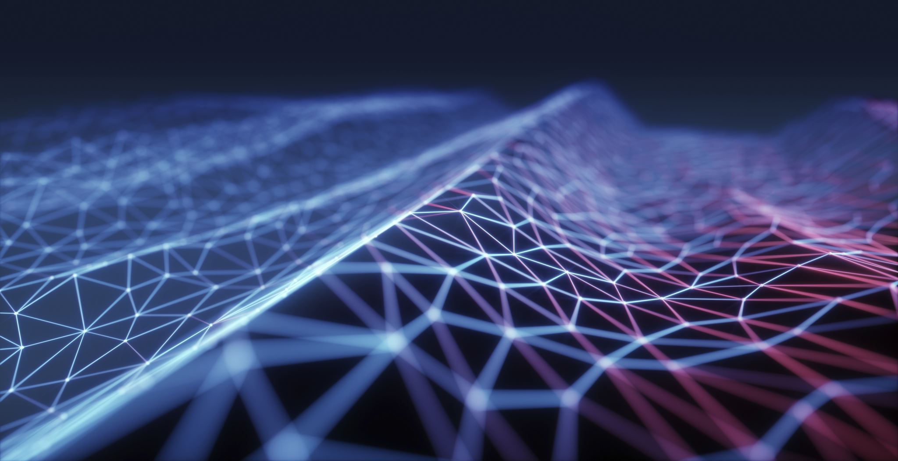
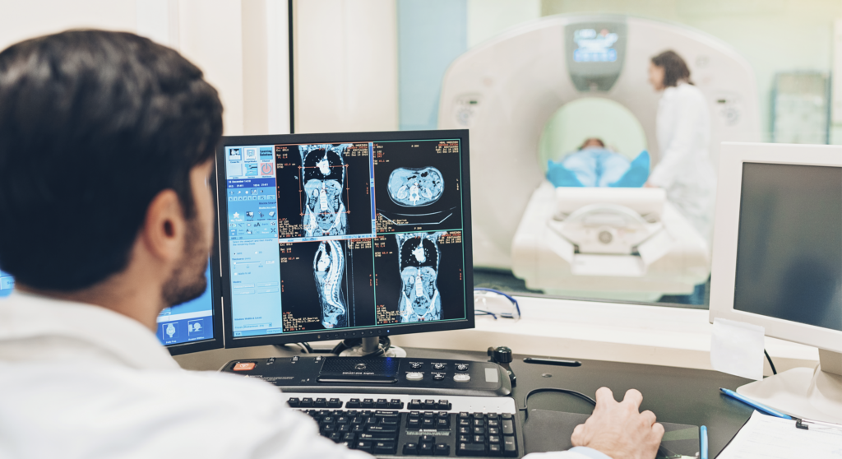
Laplacian pyramid-based complex neural network learning
for fast MR imaging
Ketbjano Vocaj – Matteo Russo – Paolo Tarantino

Slide 2
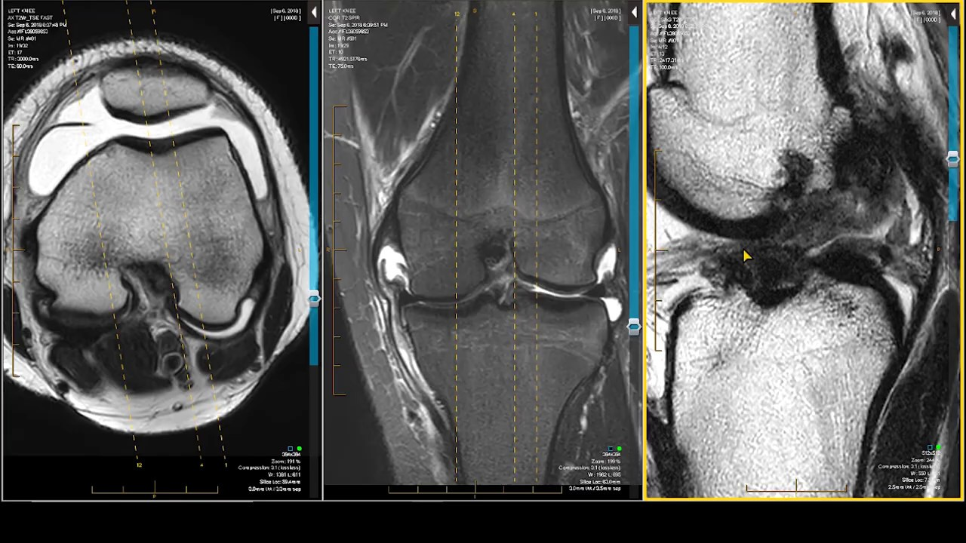
Magnetic Resonance Imaging (MRI)
From wikipedia.org: ”Magnetic resonance imaging (MRI) is a medical imaging technique used in radiology to form pictures of the anatomy and the physiological processes of the body”.

Slide 3
Purposes and issues
Issue: Scan time is the limiting factor on performance.
Goal: Find methodologies for reconstructing high-resolution images in a fast way.
Solution: undersample the k-space data.

Slide 4
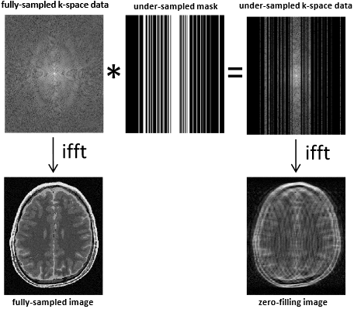
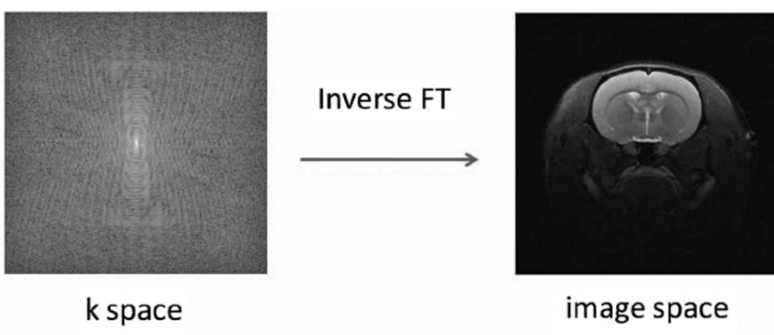
K-space and Undersampling
FT
K-space and Fourier Transform
Undersampling procedure

Slide 5
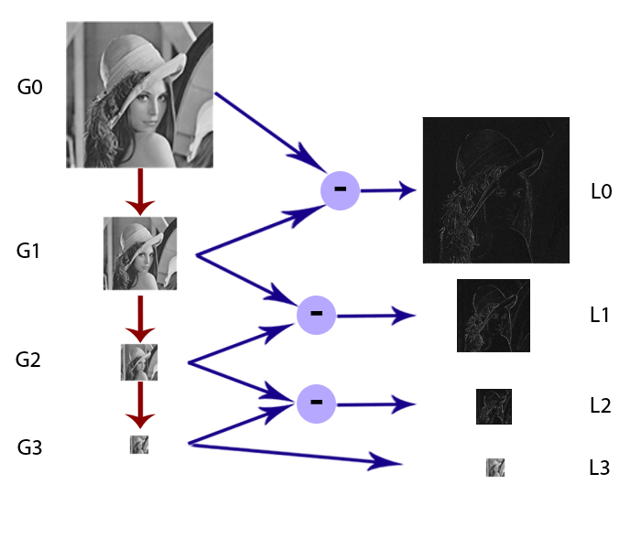
Complex Laplacian Decomposition
Gaussian Pyramid
Laplacian Pyramid
L₀ = G₀ − G₁

Slide 6
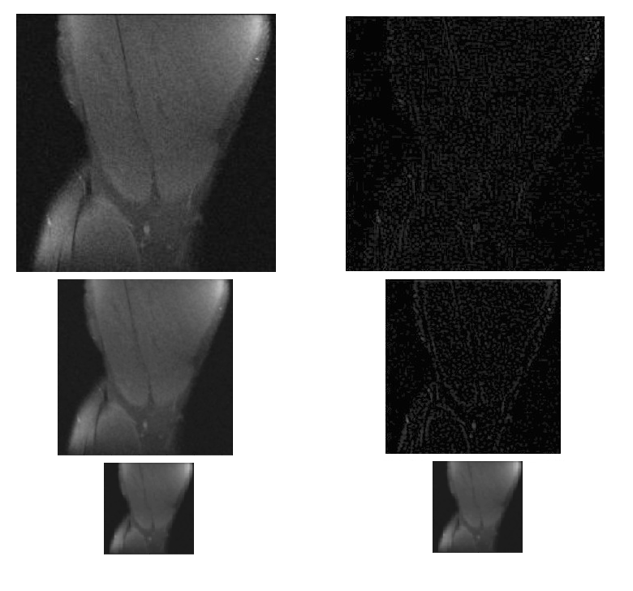
Complex Laplacian Decomposition (2)
Gaussian Pyramid
Laplacian Pyramid

Slide 7
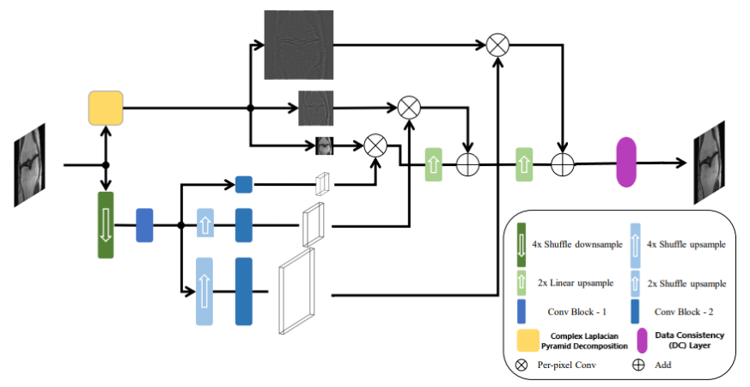
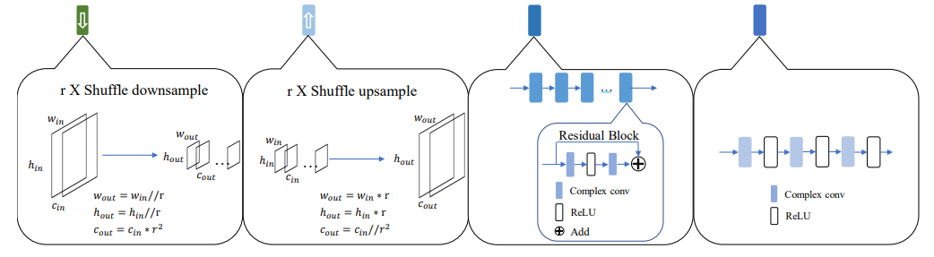
Network’s Structure

Slide 8
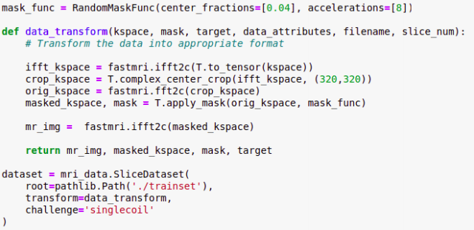
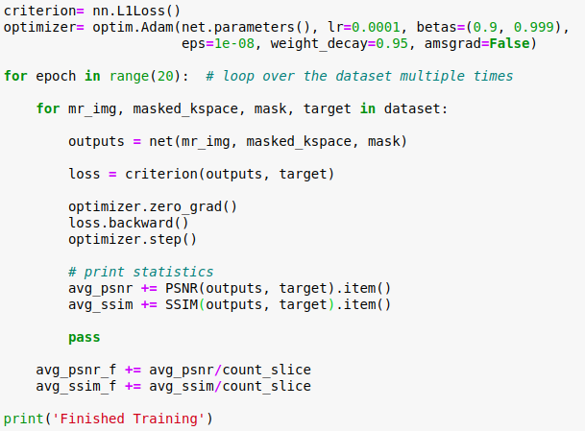
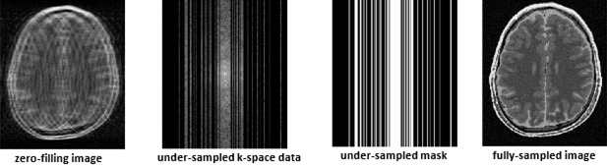
Training The Network
Training code
Pre-training
Data employed

Slide 9
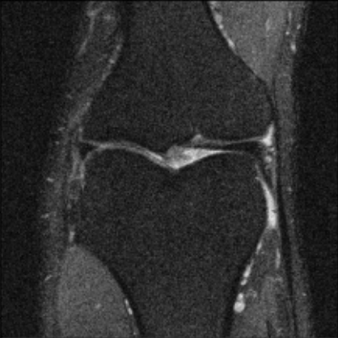
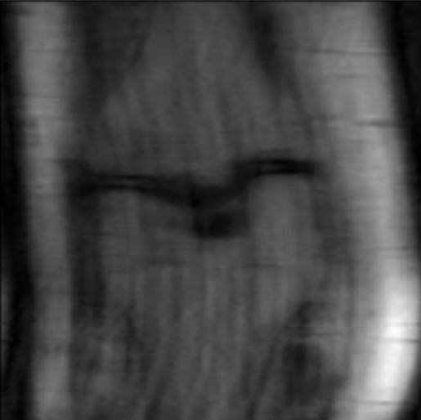
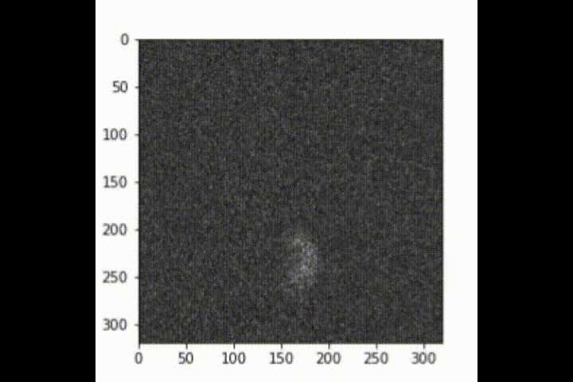
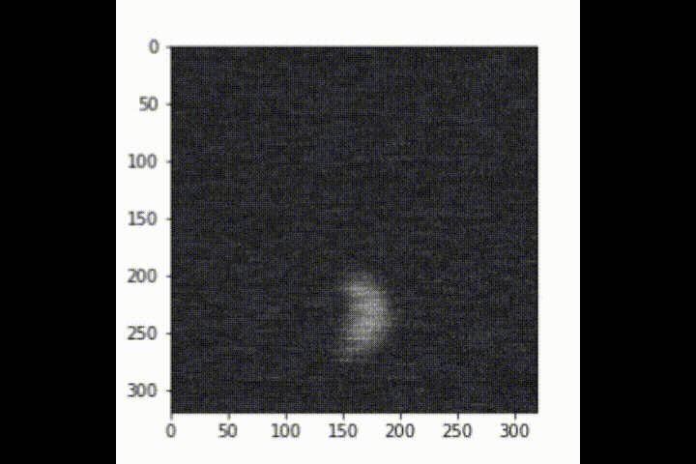
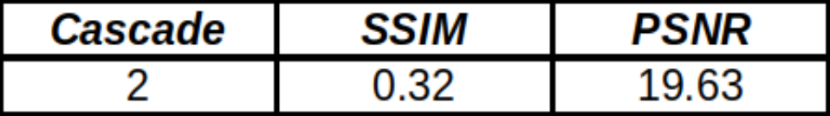
Testing and Results
Undersampling
Cascade loop
Fully Sampled (target)
Network outputs
Results obtained

Slide 10
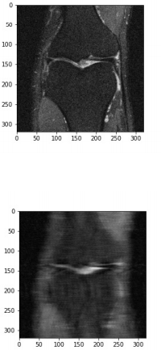
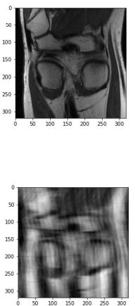
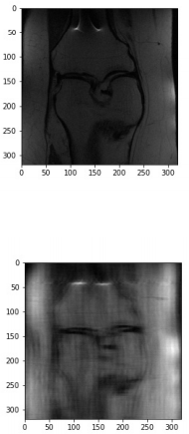
Testing and Results (2)

Slide 11

The end ☺

